Slide 1


MY DAY TO DAY AT WORK

Slide 2
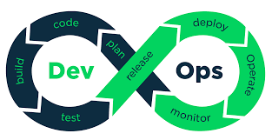

MY DAY TO DAY AT WORK

Slide 3


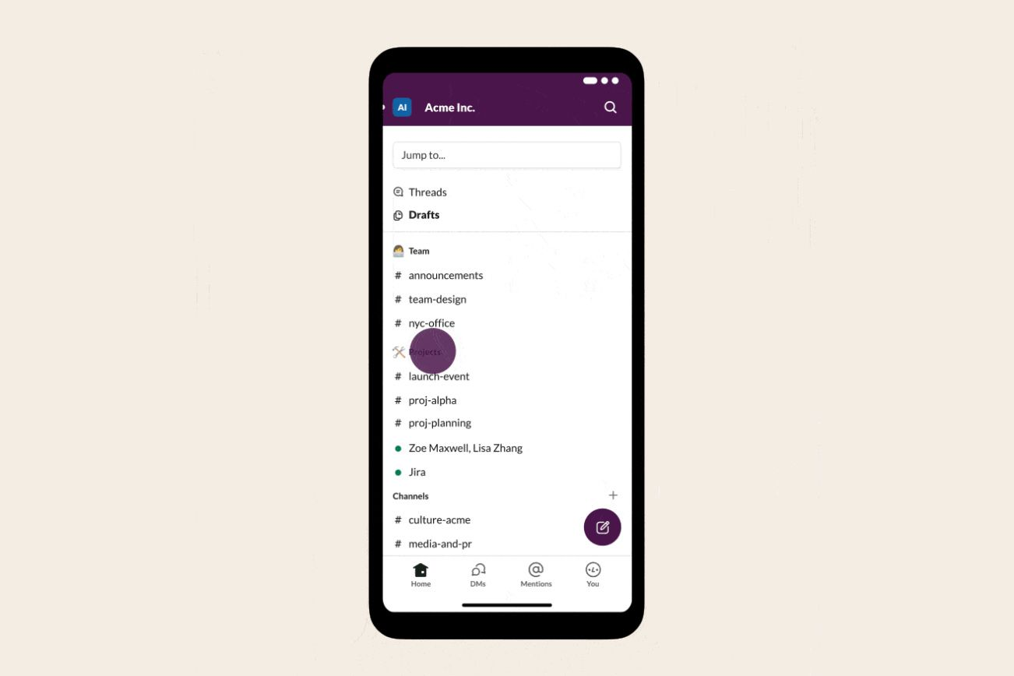
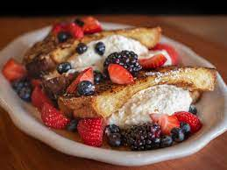
Read communications tools
Read my emails
Check the on-call channel on slack from my phone while taking my breakfast
Read my slack messages as soon as I am connected

Slide 4

Read communications tools

Slide 5
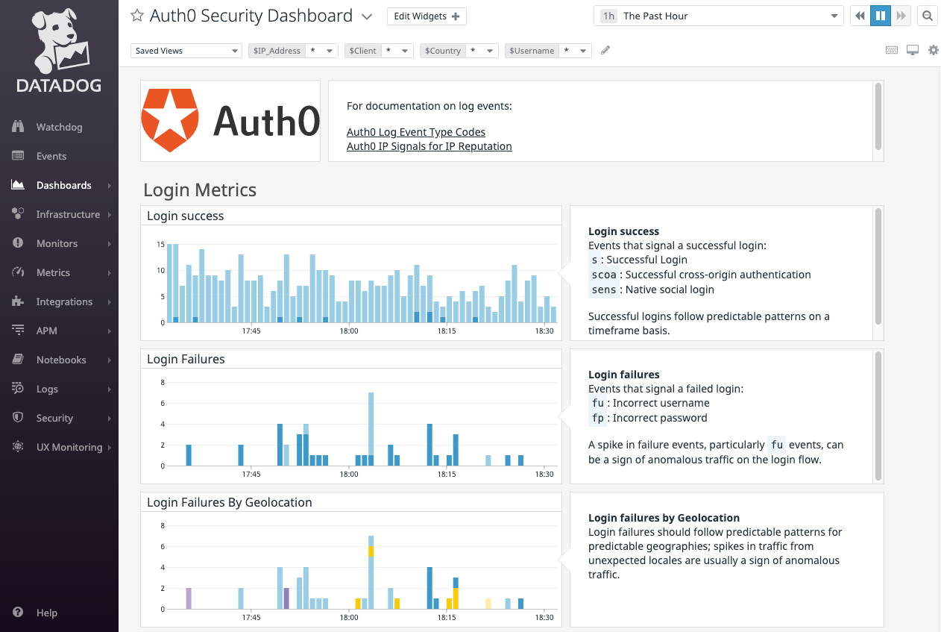
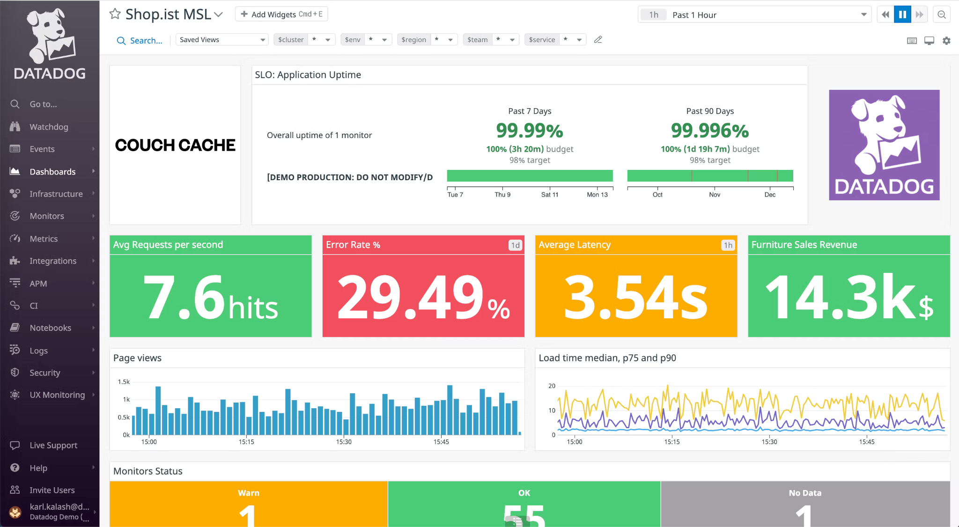
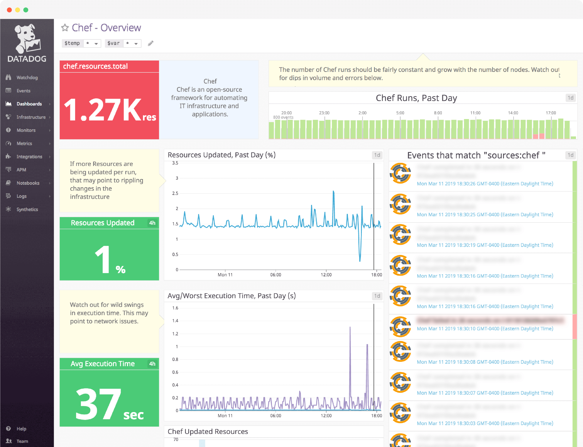
Environment health check walkthrough via DataDog
Check Apps dashboards
Check K8S dashboards
Check VM dashboards

Slide 6
Environment health check walkthrough via DataDog

Slide 7
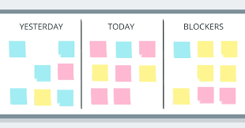
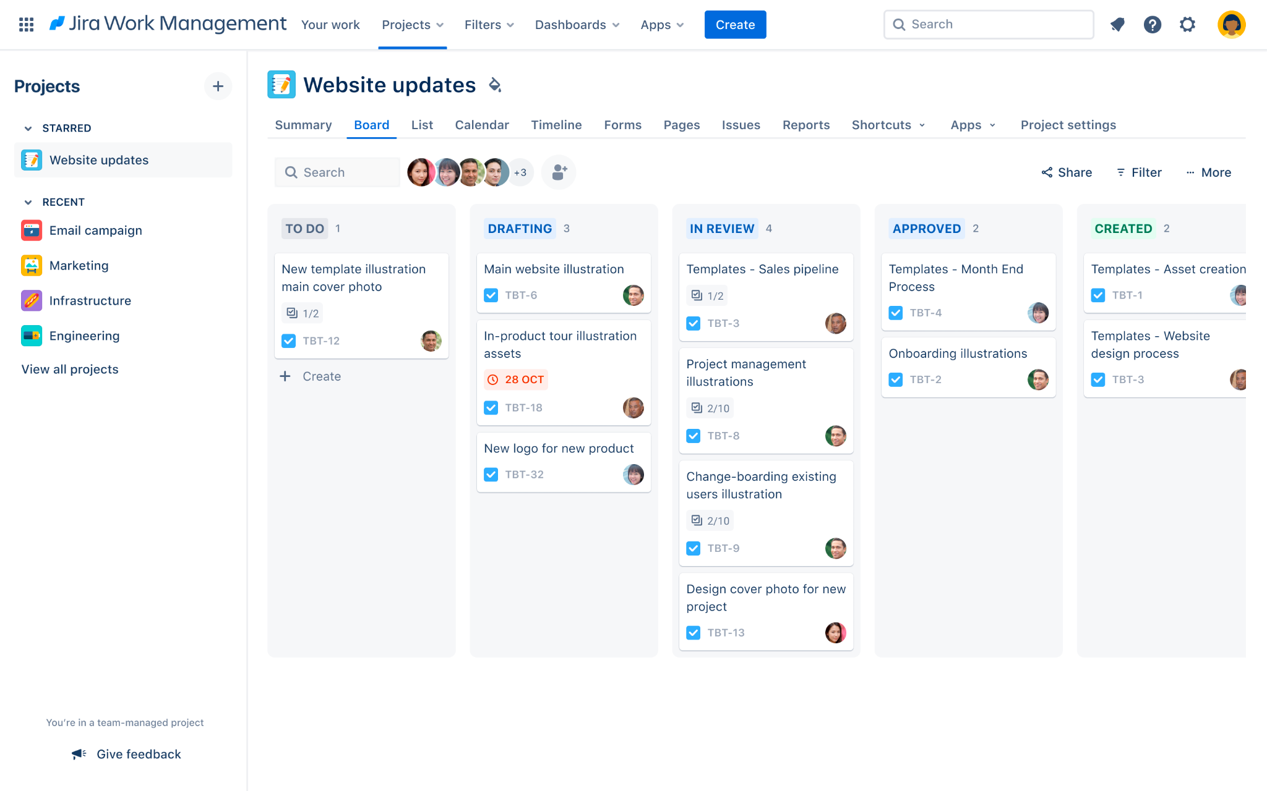

Planning
check calendar for meetings
Checks my jira tickets board
Plan for the day

Slide 8
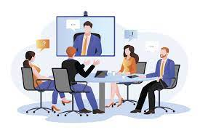
Tickets
Attend all others meetings scheduled for the day
Attend daily standup
Get prepare for stand up
Start working

Slide 9
Tickets

Slide 10


Slide 11


